Slide 1
Welcome to Fulham Palace
Voices
from
the past
Notes:
Tell the children that they are going to learn about a place called Fulham Palace. They will meet some of the people who lived at the Palace and imagine what it was like and what people might have said.

Slide 2
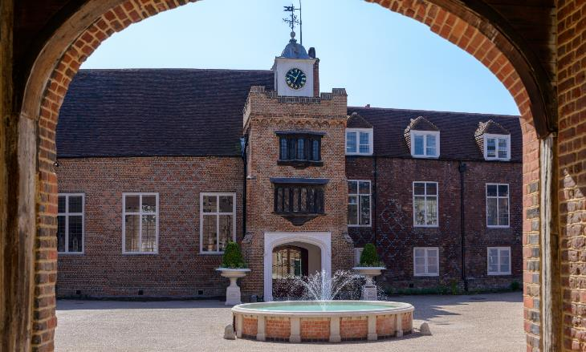
Welcome to
to Fulham Palace
Fulham Palace is just by the River Thames - has anyone visited here?
Notes:
Fulham Palace is a large country house by Putney Bridge, next to the River Thames
Ask What do you expect a Palace to look like?

Slide 3
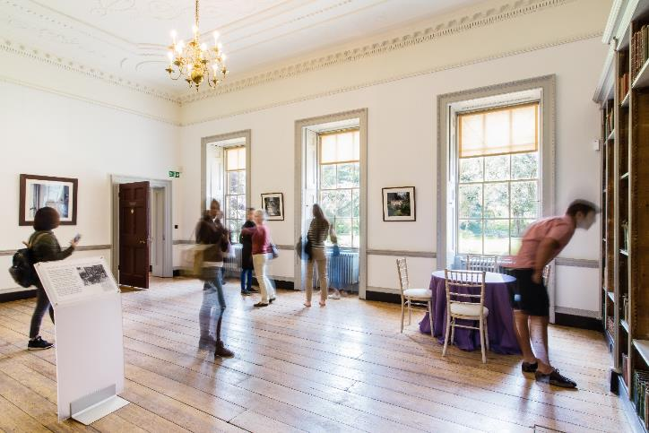
What does it
look like?
Notes:
Fulham Palace is a garden and house, the earliest part is Tudor (1485-1603), other parts were added in Georgian (1714-1837) and Victorian (1837-1903) periods.
This picture shows a Georgian room built in 1813. Slide 2 shows the Tudor courtyard.
Ask Is it the same or different from your home?

Slide 4
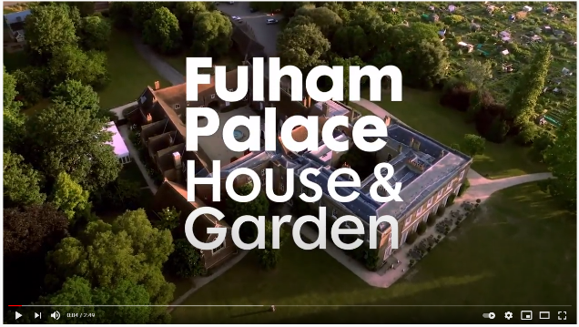
A home
like yours?
A Palace is where an important person lives.
Let’s look at the Palace
Notes:
Fulham Palace was first built in 704AD, none of this original building has survived. The picture here is the Tudor courtyard.
Play
Play the YouTube video ‘Introducing the new Fulham Palace’ (2.49m) https://www.youtube.com/watch?v=7m6A2Bb6nCI - Click the picture to open the link.
Discuss the similarities and differences between the Palace and your home

Slide 5
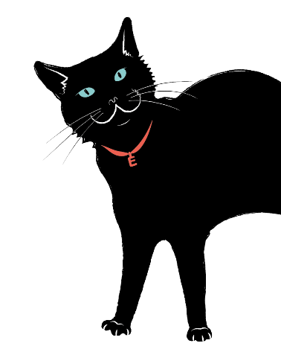
Who
lived at
Fulham Palace?

Slide 6
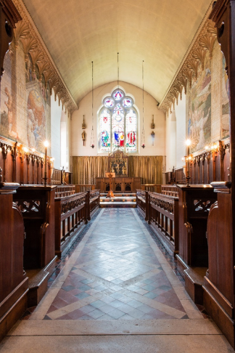
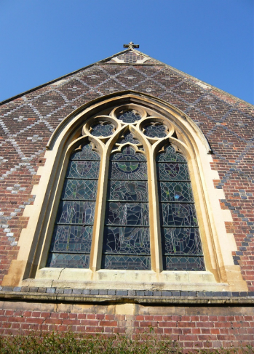
Who lived in
Fulham Palace?
Notes:
The picture shows the Victorian Chapel, build in 1867.
Ask Who do you think lived at Fulham Palace?
Ask Was it the same or different to your home? Who do you think lived here? What type of person lived in the Palace?

Slide 7
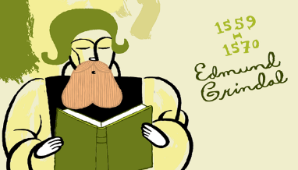
Who lived at Fulham Palace?
The Bishop of London!
Notes:
The name ‘Palace’ is commonly used for monarchs homes. The Bishops were considered ‘Princes of the Church’ hence the name.
Ask the children do they know what a Bishop is?

Slide 8
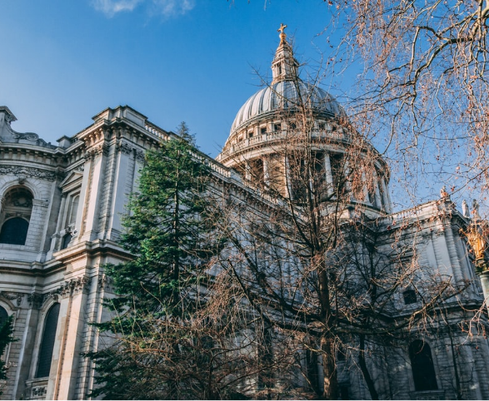
Who is the
Bishop of London?
The Bishop of London is the leader of St. Paul’s Cathedral.
The Bishop is important because they are in charge of all the other churches in central London.
Notes:
Bishops are leaders within the Christian faith and in charge of all the churches in London. The Bishop of London is so important they meet with the reigning monarchs, and are often involved in state ceremonies such as royal weddings and coronations.

Slide 9
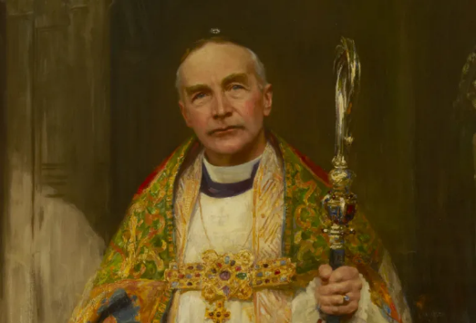
How many bishops
have lived at the Palace?
There have been 120 bishops living at the Palace over 1,300 years.
Each Bishop moved in with their household and stayed a few years…then moved out to make room for the next Bishop of London.
Notes:
The painting is of Bishop Winnington Ingram 1901-1939. He allowed the Palace to be used as a hospital for injured soldiers from WW1.

Slide 10
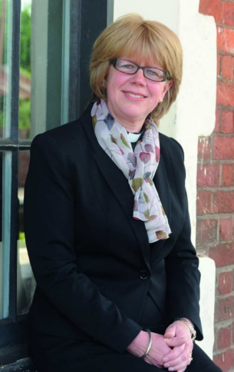
Bishop Sarah
Mullally
There have been 120 bishops living at the Palace over 1,300 years.
The current Bishop of London is Sarah Mullally, the first female Bishop of London.
She does not live at the Palace. The last Bishop left Fulham Palace in 1973.
The Palace can now be visited by everybody – including YOU!
Notes:
The last Bishop lived at the Palace until 1973.
The current Bishop of London lives in Central London. Before becoming a bishop, Sarah Mullally was a nurse.
The Palace opened as a museum in 1992

Slide 11
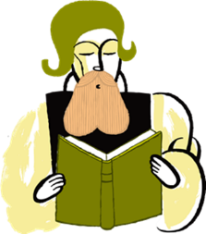
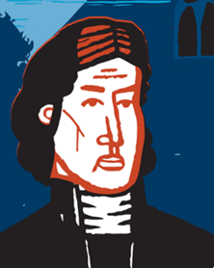
The bishops loved
living at the Palace!
Imagine what they might have said…
‘The River Thames is right by the Palace. I get in my boat and easily get to St Paul’s Cathedral’
Bishop Grindal
‘I love the woods and the countryside. It is so peaceful’
Bishop Tait
Notes:
Bishop Grindal (1519-1583) welcomed Elizabeth I to the Palace, she stayed for a magnificent banquet.
Bishop Tait (1811-1882) lost four daughters to scarlet fever before coming to the Palace. Queen Victoria supported him becoming Bishop of London as he needed to recover from the tragedy in the peaceful environment of the Palace.

Slide 12
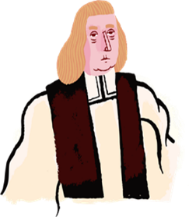
The bishops loved
living at the Palace!
‘I like the big garden because I can grow lots of
different plants. I am particularly pleased with my
tomatoes’
Bishop Compton
‘I can get over the river easily using the bridge’
Bishop Sherlock
Notes:
Bishop Compton (1632-1713) was a renowned botanist who gathered exotic specimens to grow at the Palace, these included tomatoes and coffee.
Bishop Sherlock (1678-1761) made major changes to the building by adding on the Georgian section of the Palace.
Ask the children what they like about where they live.

Slide 13
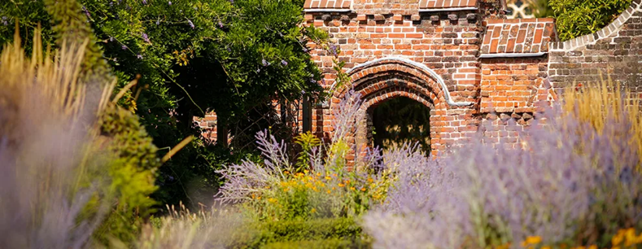
Do you agree
with what the Bishops say?
Let’s look at the Palace from the air
Notes:
Play the Youtube video from 2.28-4.00 ‘Fulham Palace From the Air’ https://youtu.be/54nqQiXui3g?t=148 – Click the image to watch the video.
Ask As we watch the video can you spot the 1. river, 2. the countryside, 3. the garden and 4. the bridge?

Slide 14
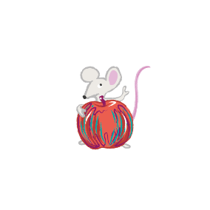
What would you
like about living
at the Palace?

Slide 15
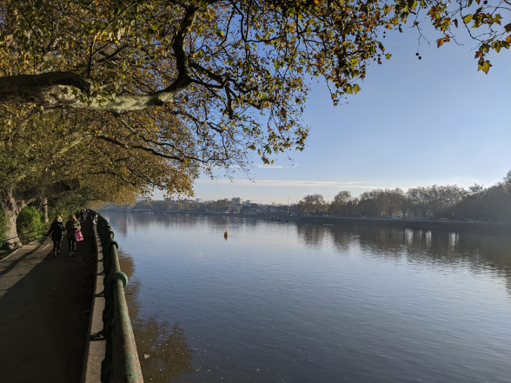
Why live at
Fulham?
River Thames
Notes:
The river is a source of water, food and means of transport. The river is the way of easily getting around just like the tube, train or bus today.
Vikings rowed long boats up the river after coming from Scandinavia. Boats still go up and down the river with people moving from one place to another.
Ask Why would you like to live next to the river?
Tell the children the Vikings liked it –they came up the river in their boats

Slide 16
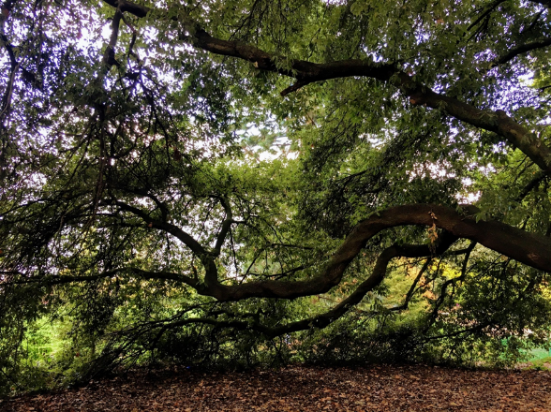
Why live at
Fulham?
The countryside
Notes:
The country side is rich in natural food and materials and Stone age people (late Mesolithic and Neolithic) used wood to make shelters, there were useful plants and lots of animals to hunt.
Tell the children that people from the stone age liked living in Fulham’s countryside too, these are the first people we know to have lived on the site. These people lived at the Fulham site around 4,000 BC.

Slide 17
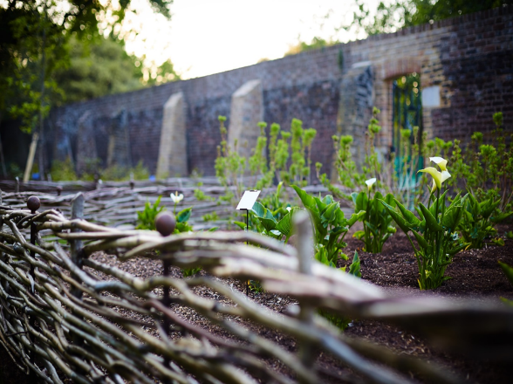
Why live at
Fulham?
The garden
Notes:
The farm at the Palace provided lots of food which was used to provide a banquet for Elizabeth I and herbs to cure Catherine of Aragon, Henry VIII’s first wife. The garden still grows delicious food such as grapes and vegetables.
Tell the children that the garden grew grapes given to Elizabeth I.

Slide 18
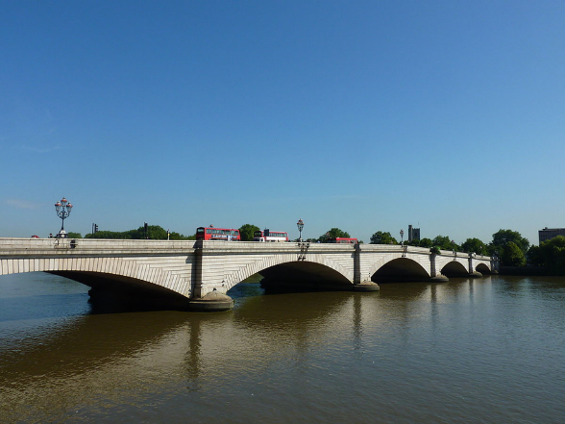
Why live at
Fulham?
A river crossing
Notes:
Putney Bridge was the second bridge (after London Bridge) to be built over the Thames. It was extremely busy.
The Romans found that the river was shallow in Putney and it was an easy point to cross. They were also close to the Roman road going into Londinium (London), a great place so they build a villa.
Tell the children the Romans found the river was shallow and an easy point to cross. They built a villa at Fulham.

Slide 19
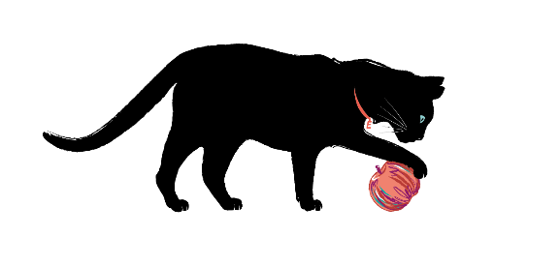
Who lived at
Fulham Palace
before the Bishops?

Slide 20
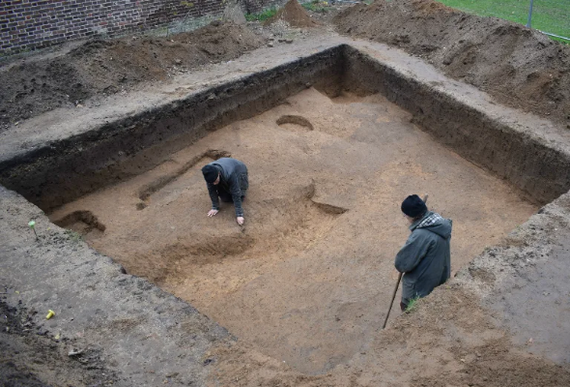
Who else lived at Fulham?
Look for underground clues!
Archaeologists find objects left behind.
The objects are often found underground.
Notes:
Digs on the site have unearthed objects dating from the Neolithic period (between 4,000 and 2,200 BC) to the modern day.
Each tells a story about how Fulham Palace was used and how it evolved over time.
Tell the children that we have seen the Palace above ground, what do clues we find below the ground tell us.

Slide 21
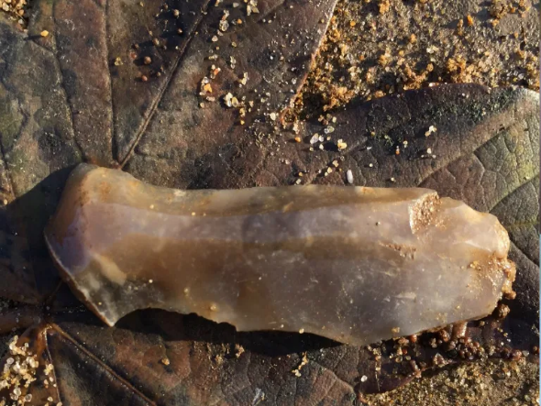
Who
left this behind?
A sharp stone tool
Notes:
A struck flint from the Late Mesolithic, Early Neolithic period, around 6,000 years ago. Finds like this one indicate that the site of Fulham Palace has long been an important one.
Tell the children it is left by stone age people. Before the Bishops Stone Age people lived at the site. They hunted the animals that came to drink from the river. They also used boats to go up and down the river.

Slide 22
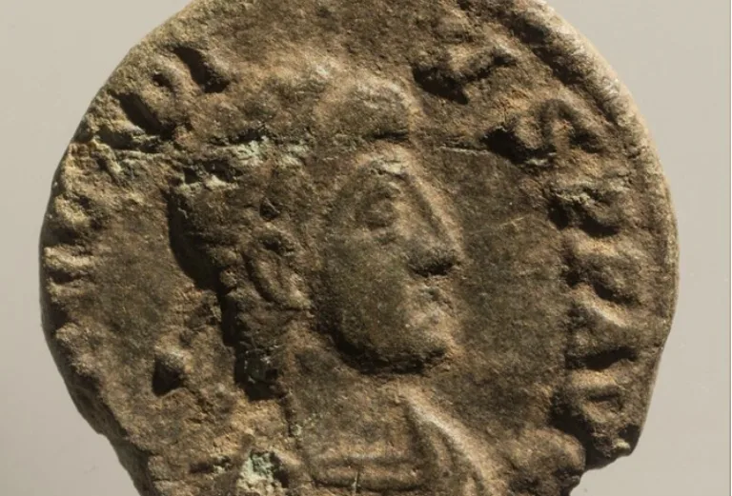
Who
left this behind?
A coin
Notes:
A Roman coin from the reign of Arcadius, AD 395 to AD 408. As the last Roman coinage entered Britain in AD 402, this discovery is evidence that the site of Fulham Palace was occupied right up until the end of the 4th century.
Tell the children before the Bishops Romans lived at the site. Roman soldiers were paid in coins, which have been discovered by our archaeologists, so we know that soldiers visited the villa.

Slide 23
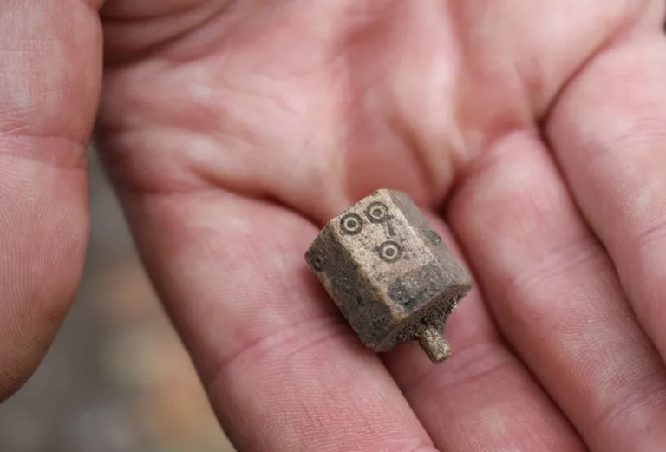
Who
left this behind?
A teetotum - these were used like dice in games
Notes:
A six-sided Tudor teetotum made from antler between 1480 and 1550. Teetotums were spinning tops used in gambling games. Discovered during our Dovecot Dig in 2017.
Tell the children the Tudor bishops had a farm in the countryside around the Palace. Some of the buildings we see today are Tudor such as the Tudor courtyard (see slide 2).

Slide 24
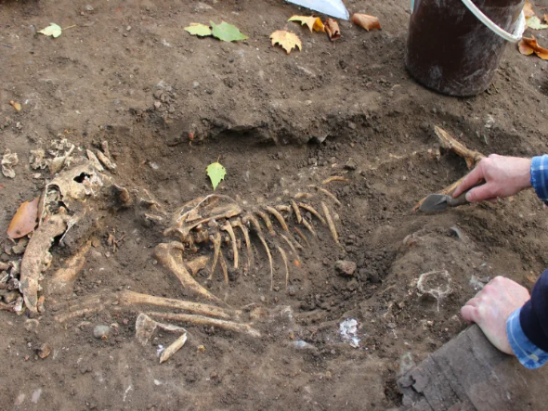
Who
left this behind?
The bones of a dog
Notes:
This is probably Bishop Tait’s dog called Captain. It was very carefully buried, it can now be seen in the Palace Museum.
Tell the children the Victorians also left lots of buildings including the Education Centre which was a stables.

Slide 25
Missing
Clues
People from the past leave many clues:
Coins
Bones
Buildings
We are still missing one big clue…

Slide 26
VOICES
Notes:
Tell the children that there are no voices from the past, we cannot hear what they might have said, how they said it or what it sounded like.

Slide 27
Let’s take a
moment and listen…
What voices do you hear now?
What are they saying?
Notes:
Listen Take a moment to listen to your surroundings e.g. 30 seconds-a minute.

Slide 28
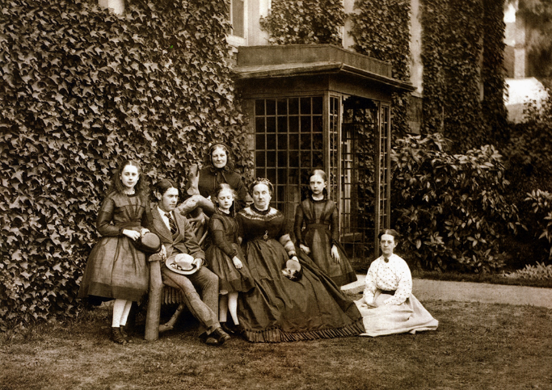
Voices from the past:
What would they say?
Notes:
This photo shows the Tait family. Lucy, Crauford, Edith, Mrs Tait and Agnes. The older woman on the backrow is unknown. The person in white is probably a governess, the rest are in black. This is probably because they are in mourning. Bishop Tait was Bishop of London 1856-1868.
Tell the children This is Bishop Tait’s family. He is not on the photo. People who lived at the Fulham Palace site do not have a voice, they have left evidence of what life was like (objects, writing, buildings and photos), but no voice, no sounds, no whispers, shouts or laughter.
What would these people like to say to us?
Activity Ask the children to imagine what they might say to us. This can be in groups or as a whole class.

Slide 29
Voices from the past:
What would they say?
Choose one sentence.
Is it whispered, shouted, high, low, fast or slow?
Create voices from the past.
Notes:
Activity Support the children in developing a soundtrack of voices to fit with the photo.
1. Ask the children for their favorite/best sentence.
2. Explore the ways the sentence can be said, how does it sound?
-encouraging, happy, pleading, (Feel of the sound)
-Is it whispered? (Volume)
-Is it slow or fast, (Tempo)
-which words were emphasized (Accent)
-a high or low sound (Pitch)
-are any words or sentences repeated (Structure)
3. Create a soundtrack of voices for the photo.
Extension children might want to explore the sounds further e.g. Will you speak in turn, blend together, over each other, in a rhythm? Will you repeat the sentence or a word?
Optional: Record the sound piece

Slide 30
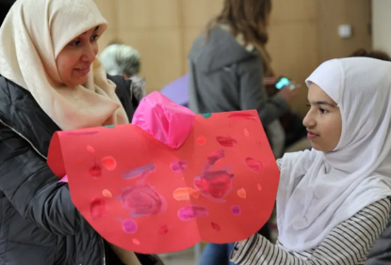
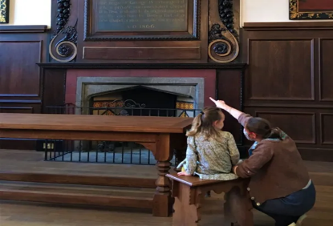
Add your voice:
visit Fulham Palace
Come and visit the Palace with your family. The grounds are open in daylight hours.
The Palace is free to visit.
Notes:
Strict Covid regulations are in place a the Palace.
The grounds are still open on a daily basis.
The House is closed until April.
Check the website for details on the House opening dates and times. Entry is free. Booking for entry is essential.
Tell the children when the Palace house is open and they visit with their family, they can obtain a free gift. The children will need to go to the welcome desk. The receptionist will ask them which school they are from and what they like about the Palace. This is valuable feedback to support our outreach projects.

Slide 31
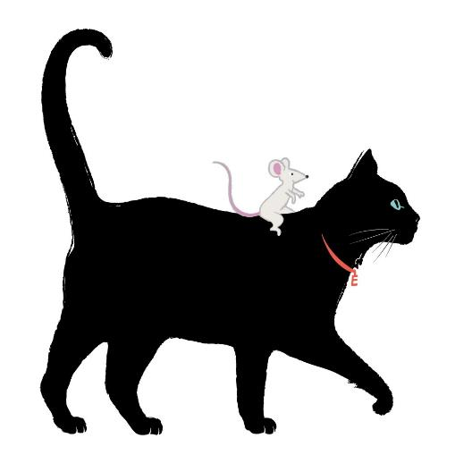
We look forward to hearing your
voice at Fulham Palace
Can you spot Edmund the Palace cat in the grounds?
Become a history detective and join Edmund and his friend Grindal the mouse as they explore the Palace with our trails!
Notes:
The grounds are open on a daily basis.
The House is closed until April. The website shows all the opening dates and times. Entry is free. Booking for entry is essential.
Tell the children the gardens are open when the Palace house is open they visit with their family, they can obtain a free gift and also we have lots of themed trails to help them explore the Palace and grounds.

Slide 32
Voices from the past
Come and make yourself heard!

